Slide 1
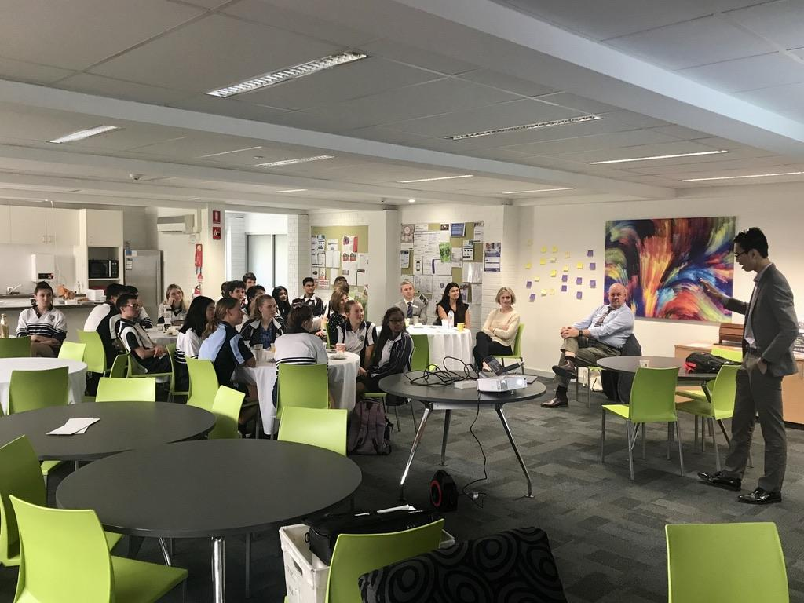

Welcome Day!
Empowering Education, Changing Lives

Slide 2
Agenda
1.. Introduction to the Team
2. Our Strategy and Impact
3. Introduction to ATAR Survival Guide Google Workplace Accounts
4. Tutorial on how to create a page for the ATAR Survival Guide
5. Student Pain Points Exercise - Creating a Better ATAR Survival Guide

Slide 3
The Team

Slide 4
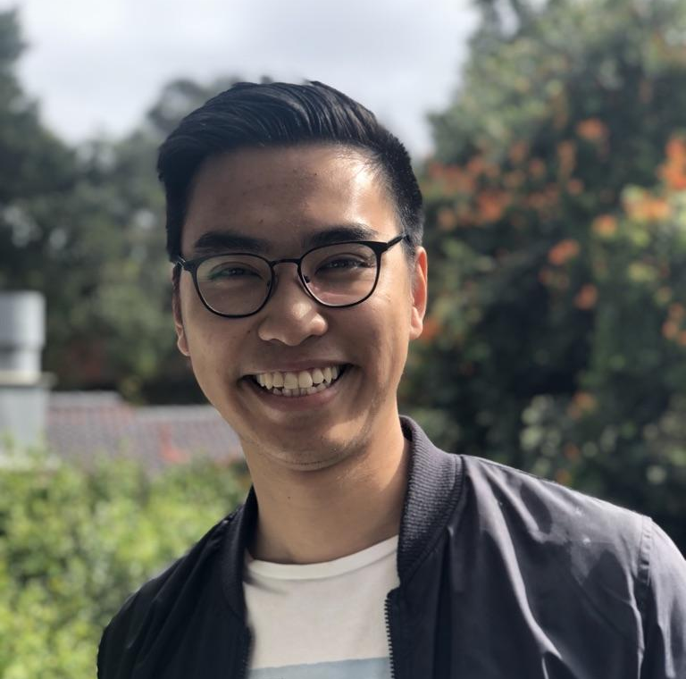
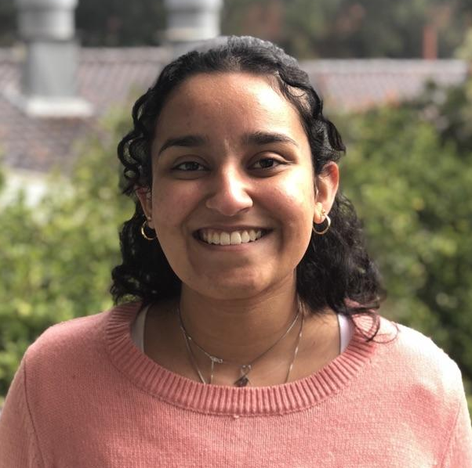
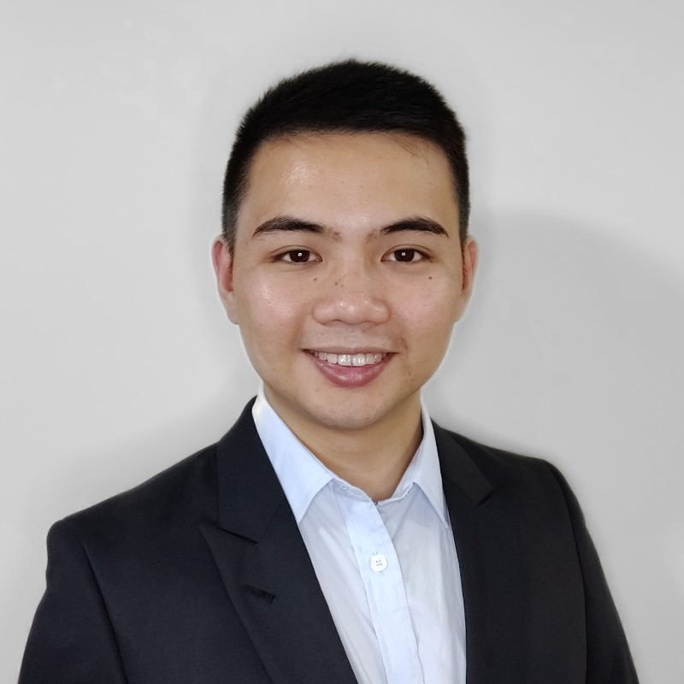
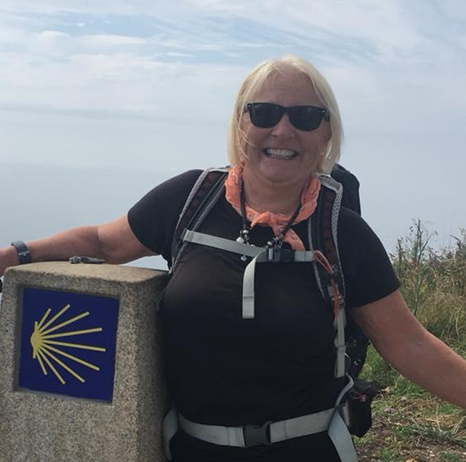

Our Team
Core Team
Advisory Team
Christian Bien
Founder
Previous Strategy Associate at FTI Consulting, Christian is a Curtin Excellence Scholar, Stanford IHP participant, founder of Curtin Consulting Group and Semi-Finalist of WA Young Achiever of the Year.
Priya Kaur
Operations Lead
Current Commerce and Law Student at Curtin University, Priya is the President of the Curtin Consulting Group and a current Curtin Excellence Scholar.
John Phung
Growth Advisor
Current Strategy & Consulting at Accenture, John has years of experience in management and was the former President of the Curtin Consulting Group.
Sally Topley
Partnerships Advisor
Sally works as an academic mentor for young people across multiple high schools. A previous Cambridge graduate, she was the former President of the Cambridge Society of WA.
Maria Barone
Education Advisor
With over 3 decades of teaching experience, Maria is an experienced educator specialising in business and technology at Duncraig Senior High School. She has previously taught Monash University.

Slide 5
Our Strategy and Impact

Slide 6
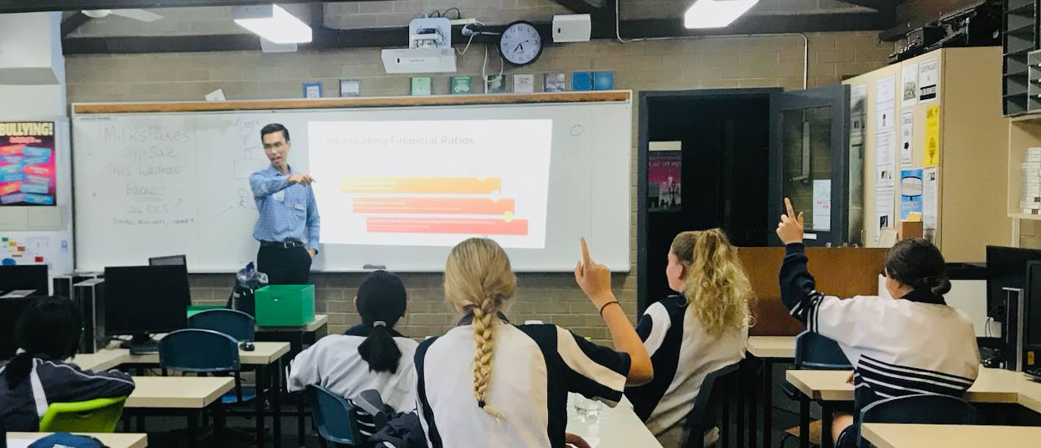
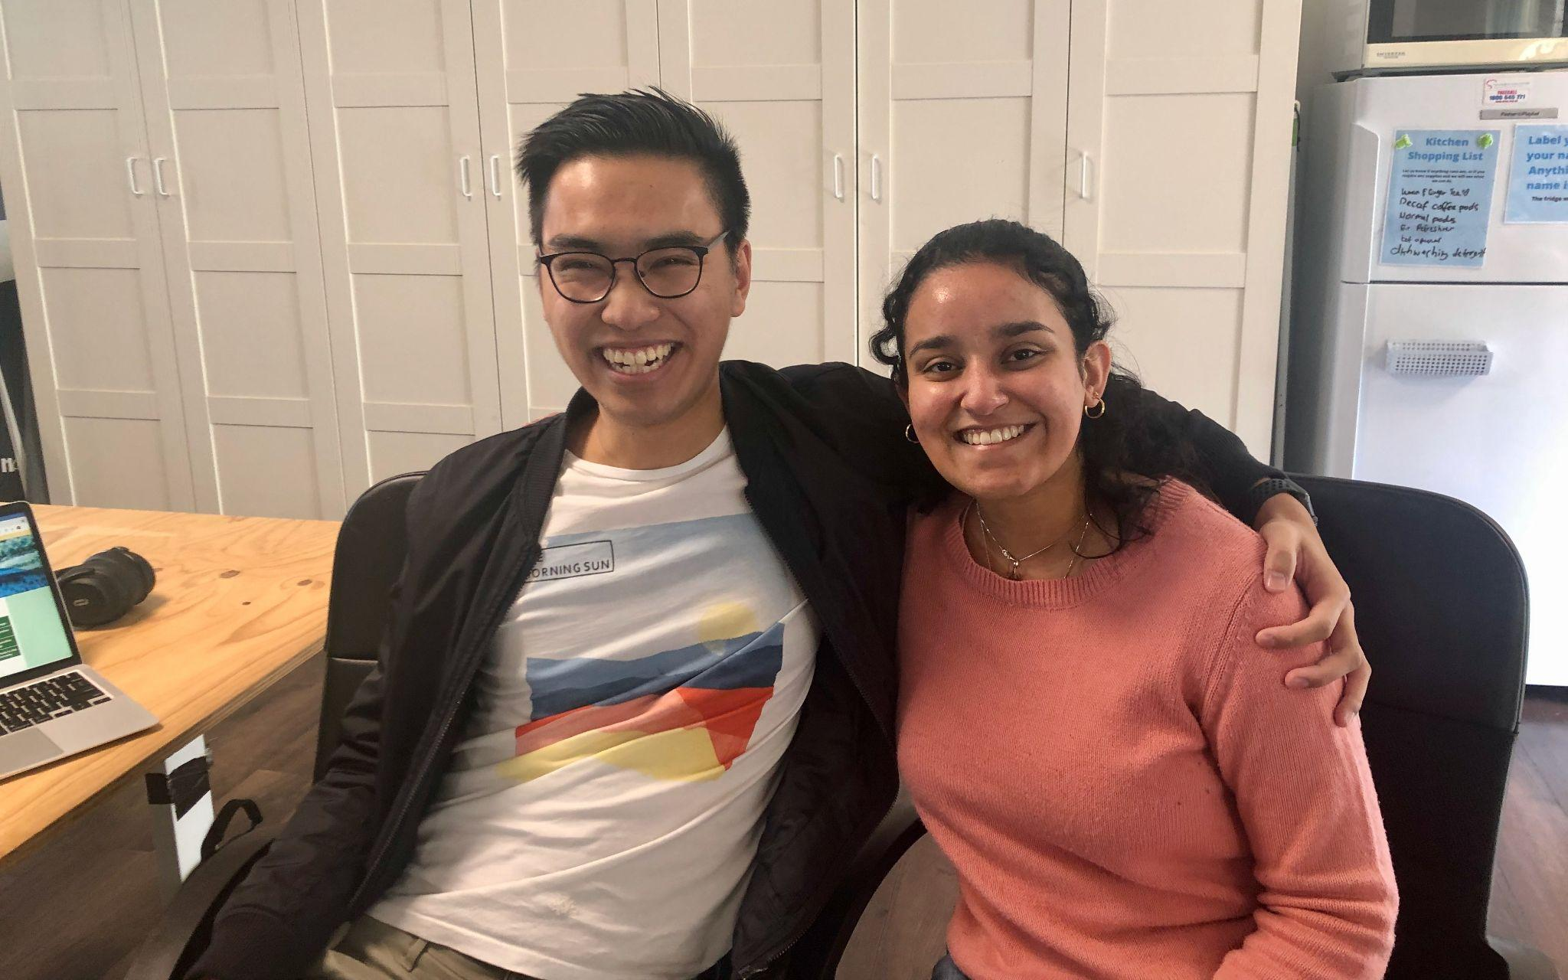
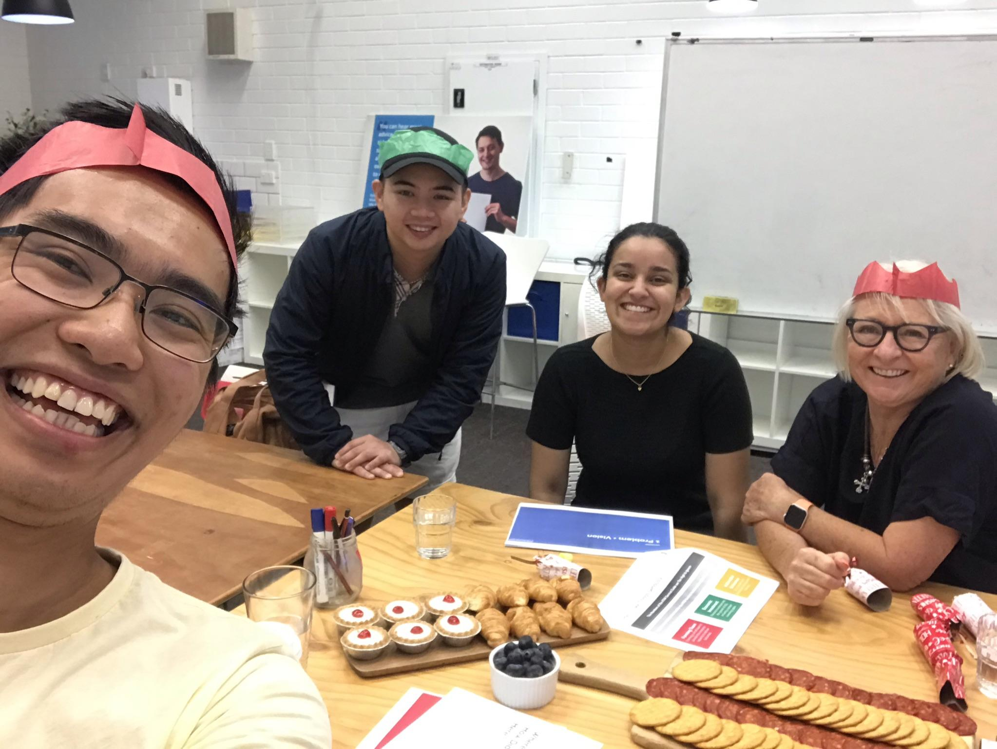
Empowering Education, Changing Lives
Starting as a project in a Year 12 bedroom, our mission has always been the same, to create simple and accessible educational platform to provide additional support regardless of financial background.
With over 77,000 users per year logging over 4,300 hours and growing, our team is creating long lasting social impact to empower the future of education!

Slide 7
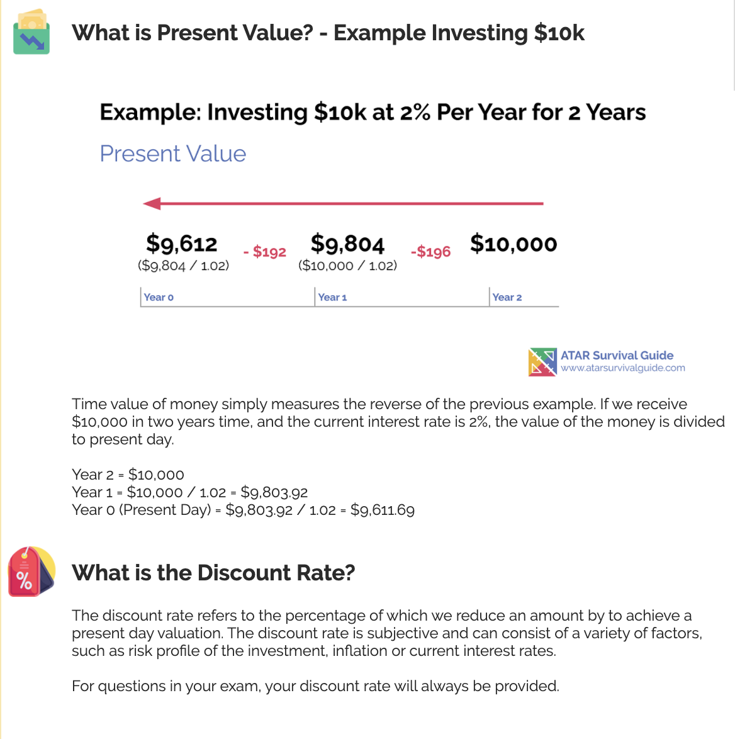
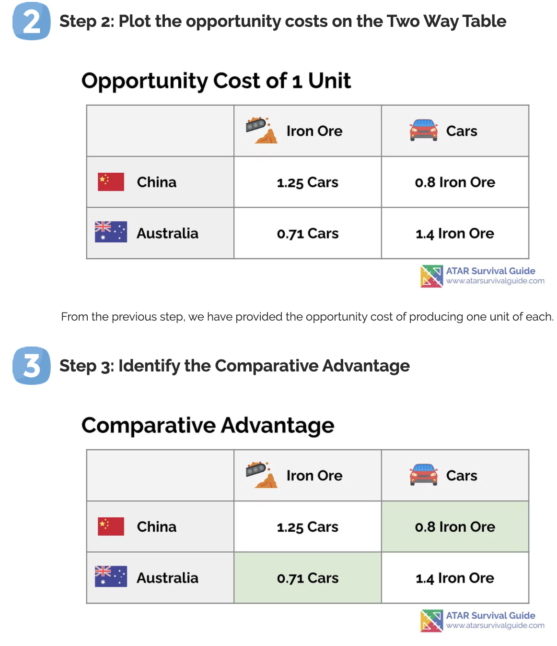
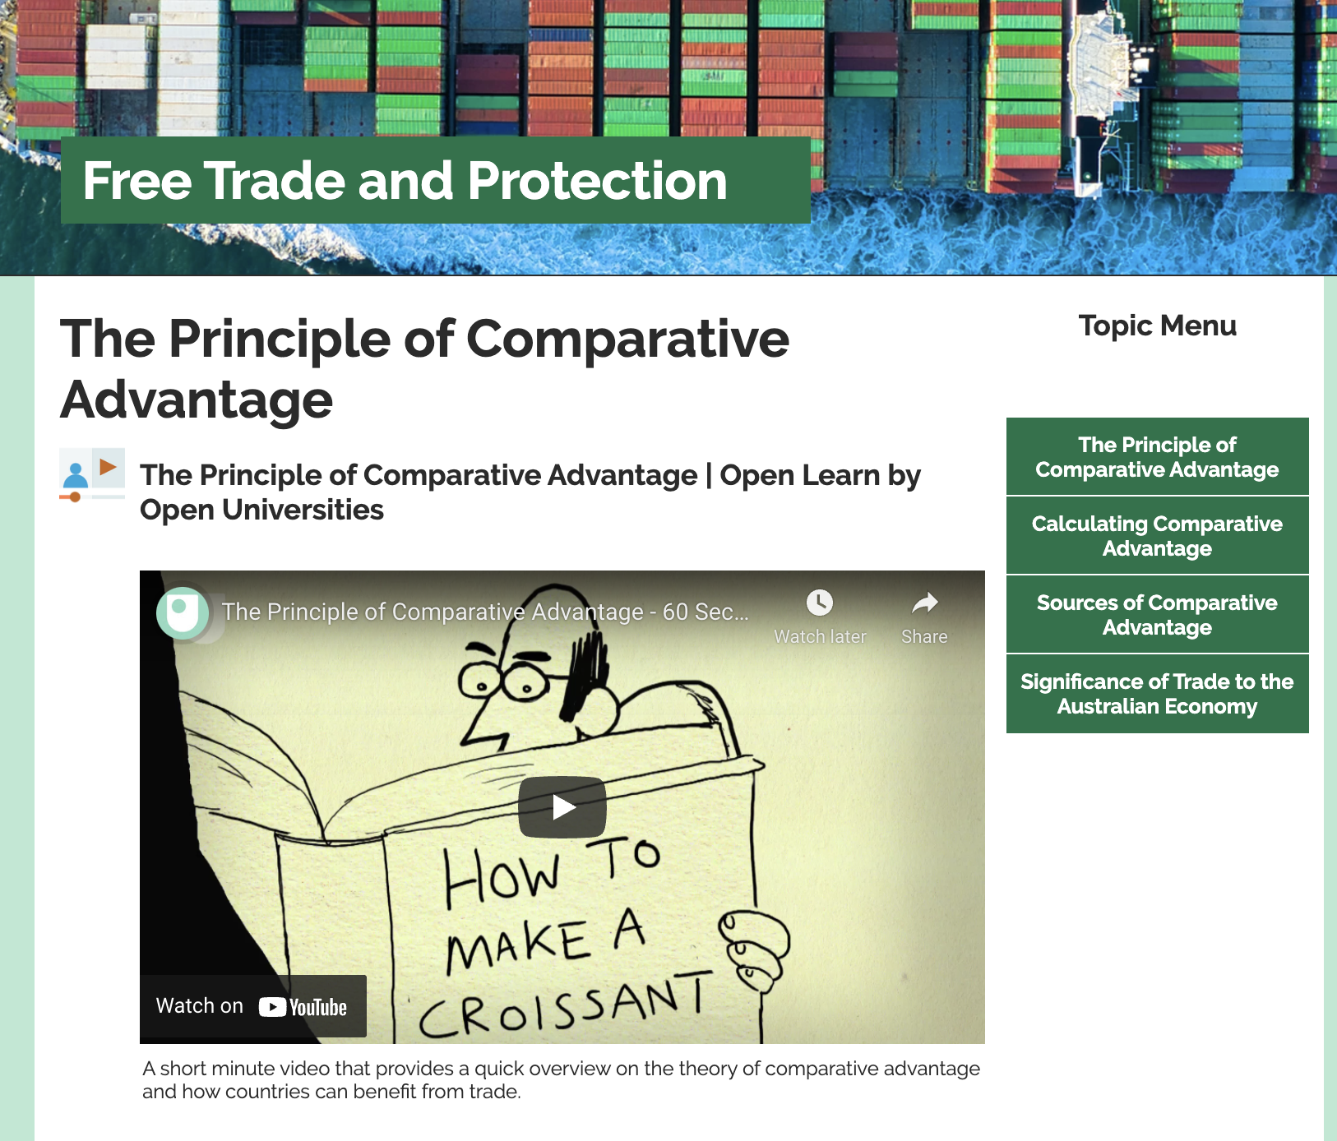
How we support students
Content Explainers
Simple to read and easy to understand notes and explainers.
Practice Questions and Step by Step Answers
Guides to understand where a student has gone right and wrong, every step of the way.
Video Tutorials
Videos collated from other content providers or provided in-house to explain concepts and walkthrough answers.

Slide 8
Our Impact
79k
Users Per Year, logging over 100k sessions
3.5k
Registered accounts on the platform
8
Subjects and growing
100%
Free
We’re here for impact not profit.
Click here to see our impact for yourself
Above link directs to the ATAR Survival Guide website

Slide 9
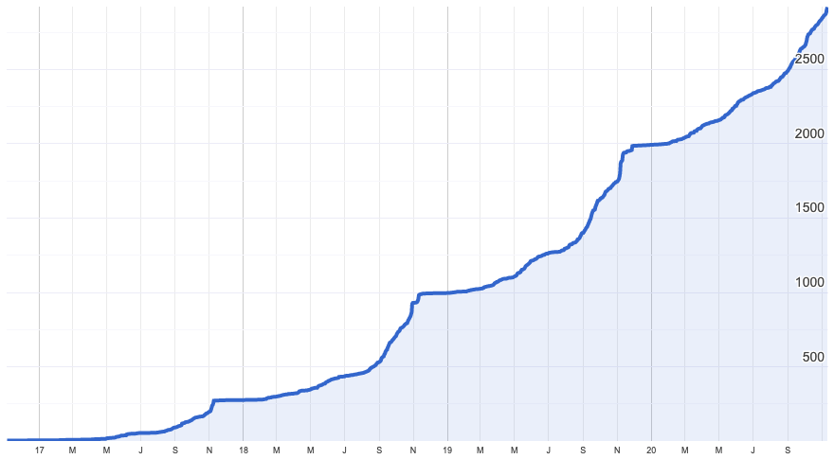
ASG has Achieved 51% YoY Member* Growth
Member User Base Growth Between 2017 to 2020
3,603
Registered Users as at 14 Aug 2021
*Members are defined as users with accounts with registered email addresses and passwords or a Facebook or Gmail login
Source: Google Analytics

Slide 10






ATAR Survival Guide Provides Opportunities to Create a High Engagement Study Platform that Meets Curriculum Requirements
Curriculum Focused
Low Student Engagement
High Student Engagement
Not Curriculum Specific

Slide 11
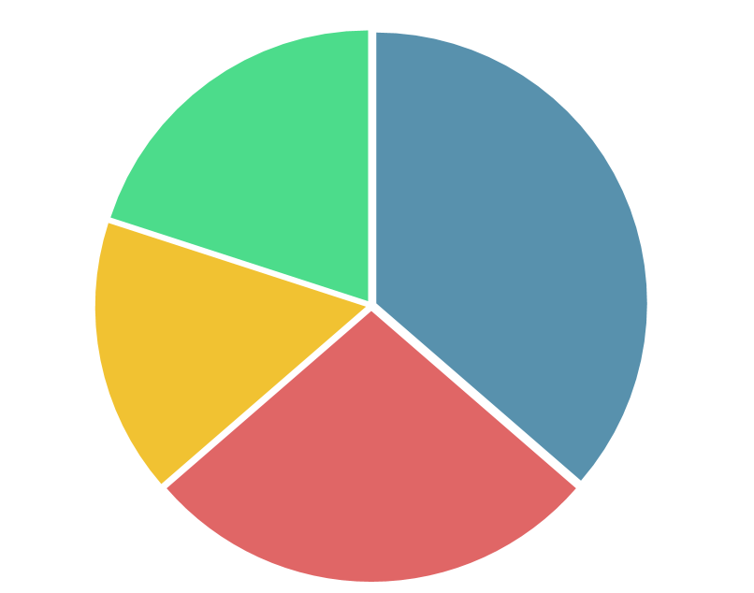
Current E-Learning Platforms are Not Meeting the Student Experience
Students Want the Following:
Insufficient Practise Questions and Solutions
Irrelevant to WACE Curriculum
CRAP Test employed on platform.
1
20 %
36.3 %
Step-by-step guidance in applying content to questions.
16.4 %
2
Unappealing Presentation
27.3 %
Varied approach: E.g. videos, diagrams to visualise concepts and aid understanding.
Credibility of Sources
3
Notes:
CRAP
Currency - Is it up to date?
Relevance/Reliability - Is the information correct?
Authority - Who is putting up this information is it qualified?
Purpose - Our purpose being syllabus focus

Slide 12
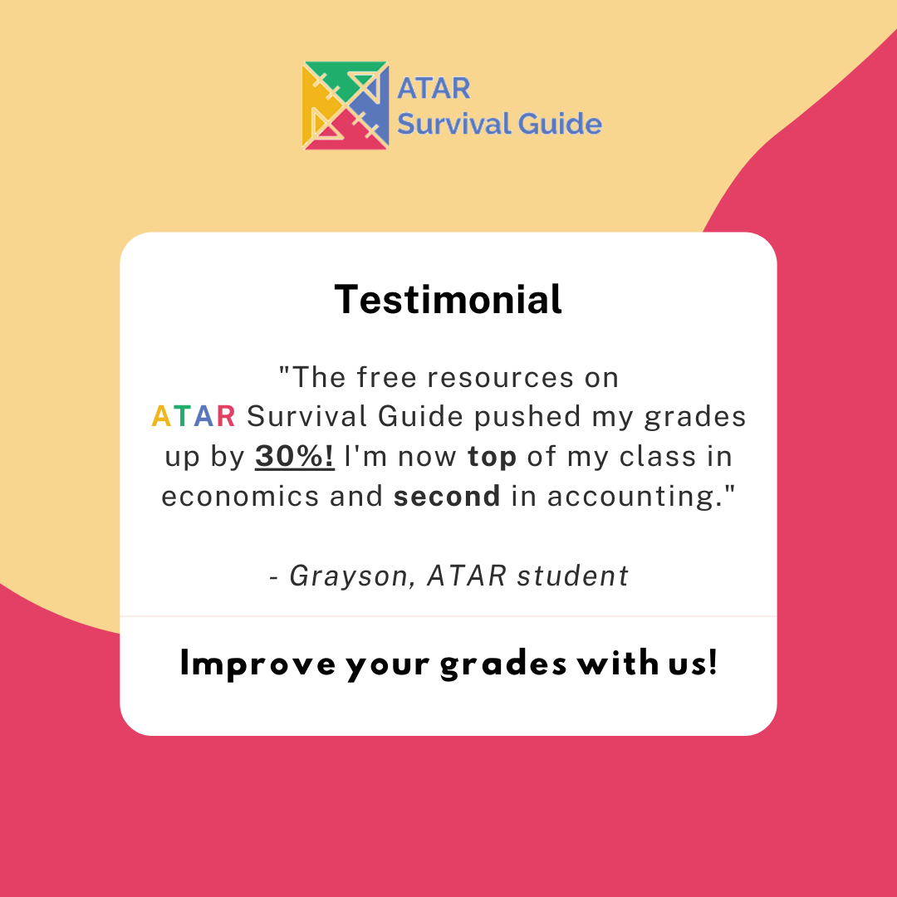
Positive Feedback Achieved on the Base Platform
“Thank you for the reply. My son Spencer is at boarding school in Perth-and we discovered your website when he was doing remote learning from home for a few weeks when the boarding houses were shut due to COVID. He really likes the way the information follows the syllabus, the practice tests in Economics at the end of a topic and the description of models and the simple explanations of changes in them ( egAD / AS model).
Thank you for the wonderful free resources and all the best for your future.”
Kaylene
(Parent from Regional WA)
“Good morning Christian,
I stumbled across your resources for AIT ATAR while cramming this morning. Very well written and thoroughly explained.
Thank you very much for compiling these.”
Chris Grieg

Slide 13
Key Milestones
Other Roles Available
Technology/Platform Developer
Technology Lead
Fundraising Lead
Marketing Lead
Schools Outreach Lead
Education Lead
Subject Lead
Student Opportunities Writer

Slide 14
Key Milestones (Short-Term)
Short Term (0 - 6 Months)
Develop 3 subjects
Endorsement by 6 schools
Obtain 6 teacher advisors
Become a not-for-profit organisation
Present at the ETAWA conference
Medium Term (6 - 18 months)
Grow the team to cover all major topics
Obtain seed funding by grant providers including Lotterywest, Local Government and State Government
Long Term (18+ months)
Obtain funding from mining companies
Leave current full time job to expand ASG to interstate markets

Slide 15
Mission Statement:
To be a universal platform that improves student results through effective and attentive study solutions accessible to all.

Slide 16
Photo Day and Bios

Slide 17
Google Workplace

Slide 18
Process of Creating Content

Slide 19
Structure of Content
Each directory page holds all the topics of the subject. Under each topic are the notes, worksheets and worked examples.
Directory Page
Topics Page
Notes
Worksheets
Worked Examples

Slide 20
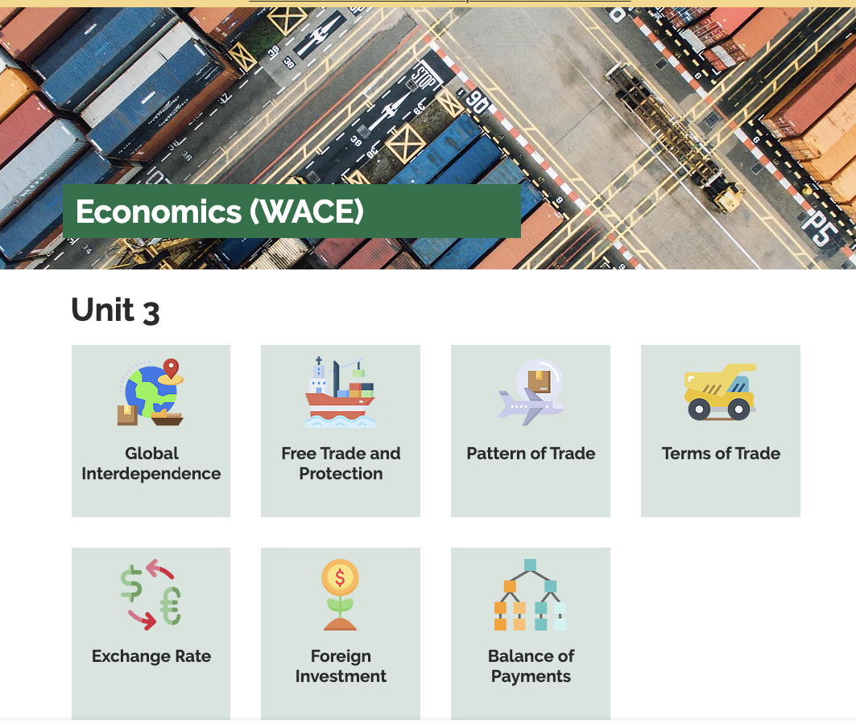
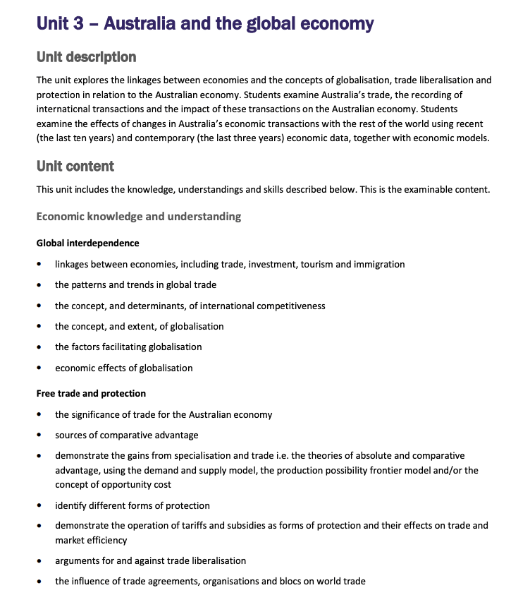
Directory Page
Topics

Slide 21
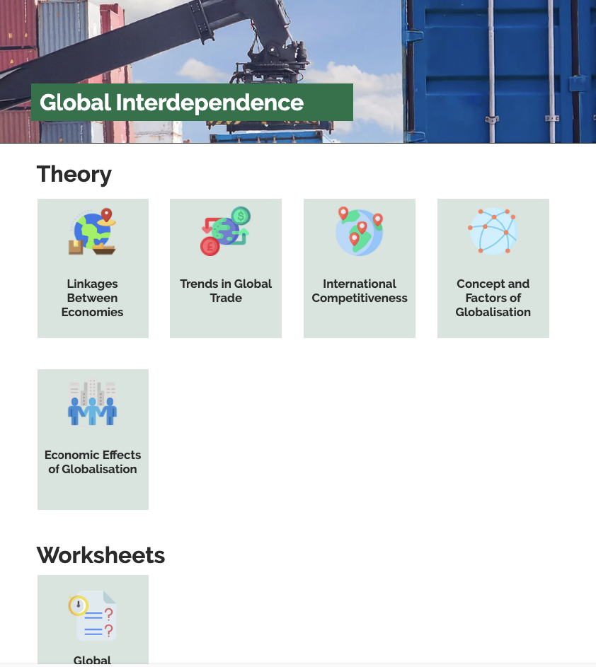
Topics Page
Syllabus Notes

Slide 22
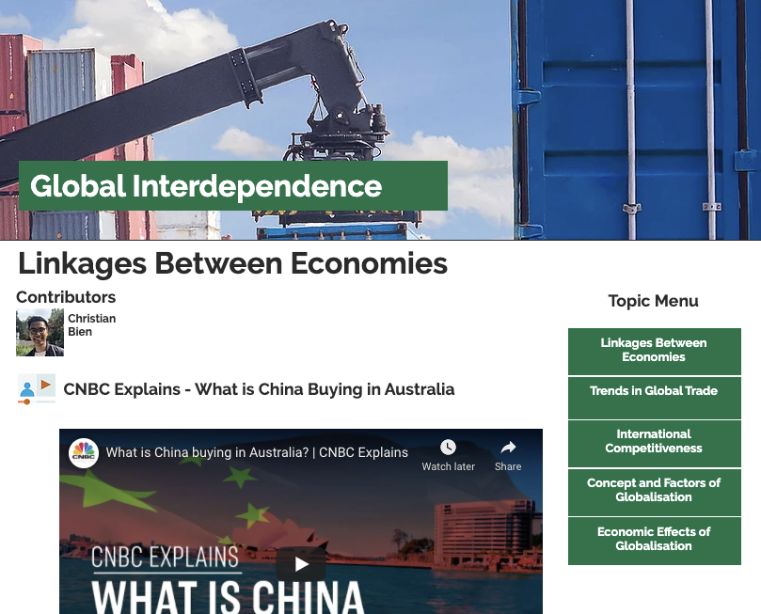
Creating a Topic
Topic Section
Create a topic heading - these will be used to group different content together.

Slide 23
Creating a Topic

Slide 24
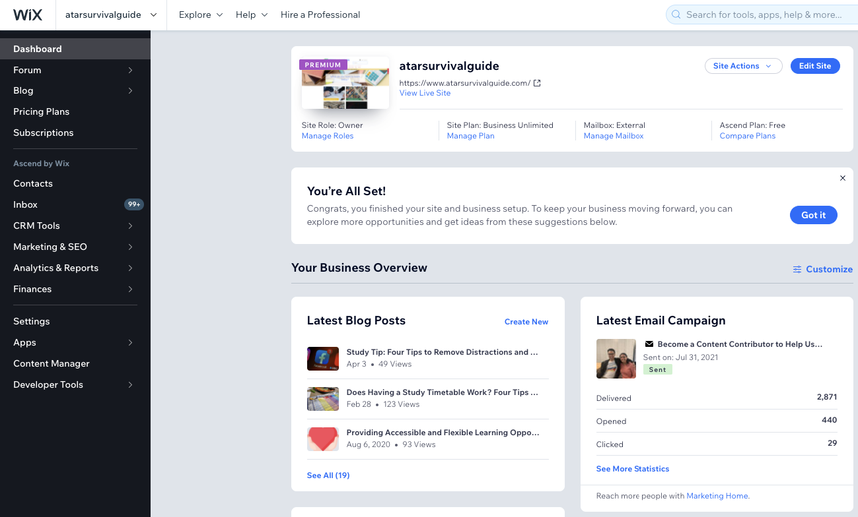
Step 1: Go to Wix Dashboard
Click on Content Manager

Slide 25
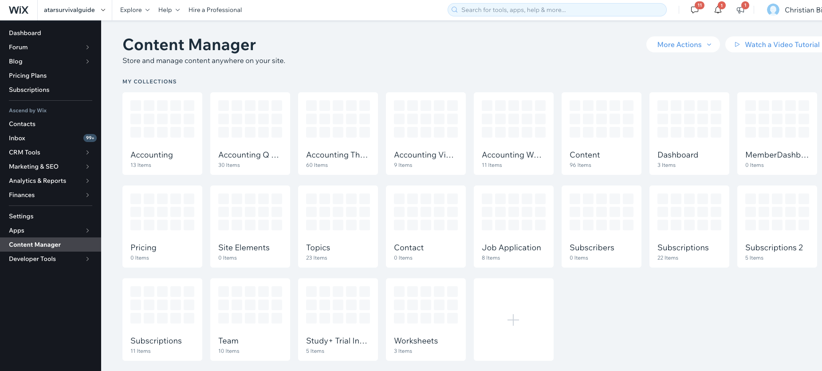
Step 2: Select the ‘Topics’ Database

Slide 26
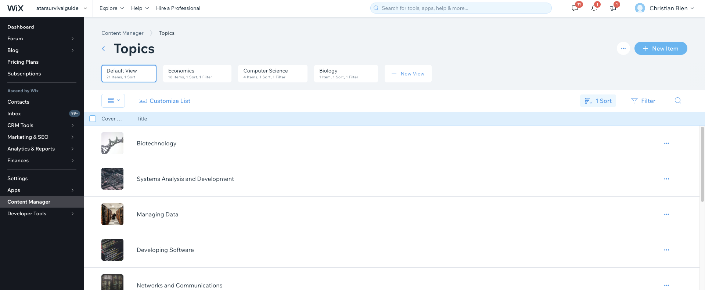
Step 3: Add New Item

Slide 27
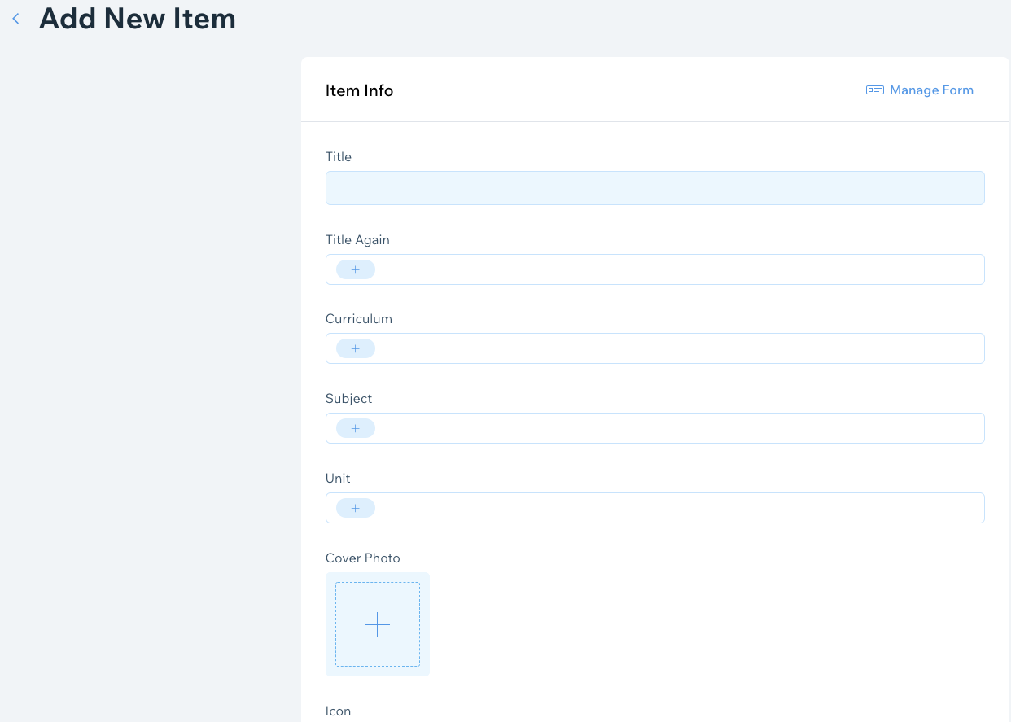
Step 4: Fill Out the Form
Name of the Topic
Name of the Topic Again
Curriculum (WACE)
Subject (E.g Economics, Biology or Computer Science)
Unit (E.g Unit 1, Unit 2, Unit 3 or Unit 4)

Slide 28
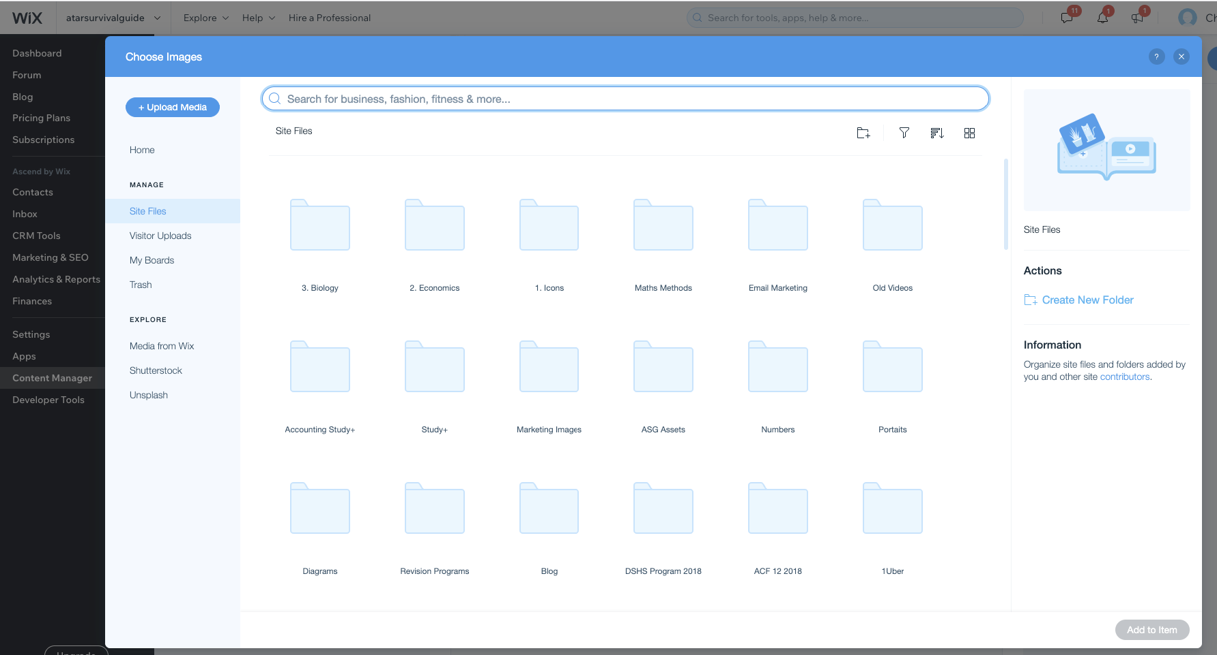
Step 5: Add Cover Photo
Search for an Image that Best Captures the Topic

Slide 29
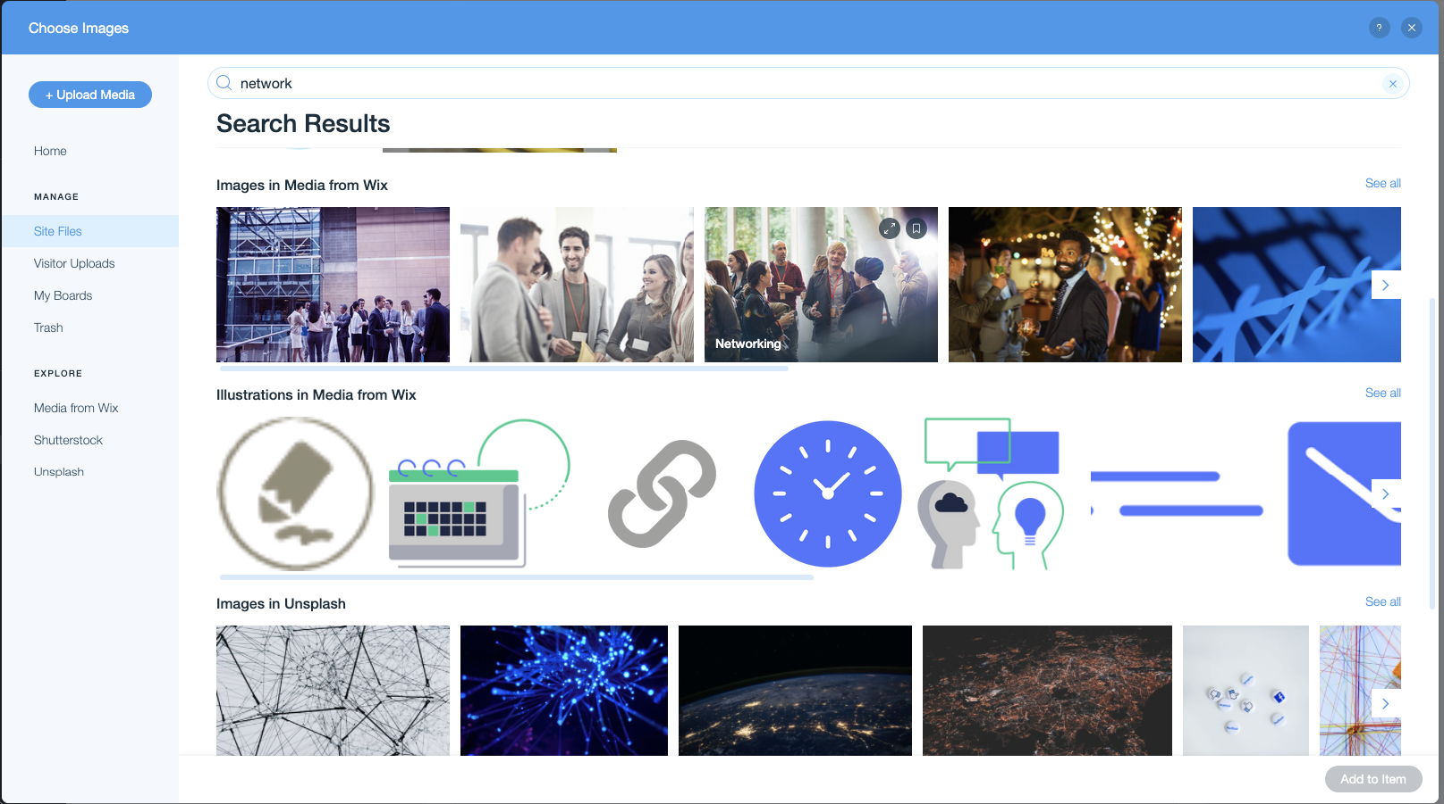
Step 5: Select an Image from Wix or Unsplash
Wix Images
Unsplash

Slide 30
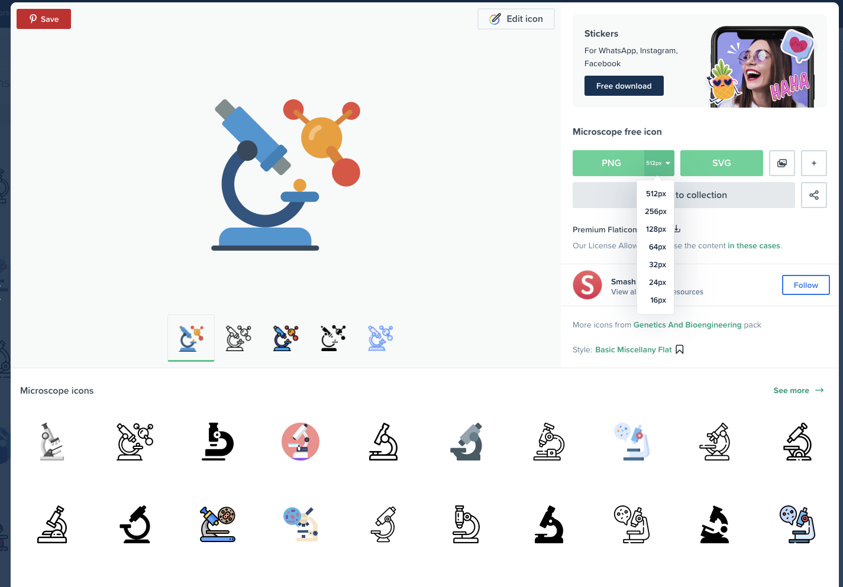
Step 6: Find an Icon
Head to FlatIcon.com and use the following login details:
Email: christian.bien@atarsurvivalguide.com
Password: ah3y6chXUz!
Download an Icon size of 256px.

Slide 31
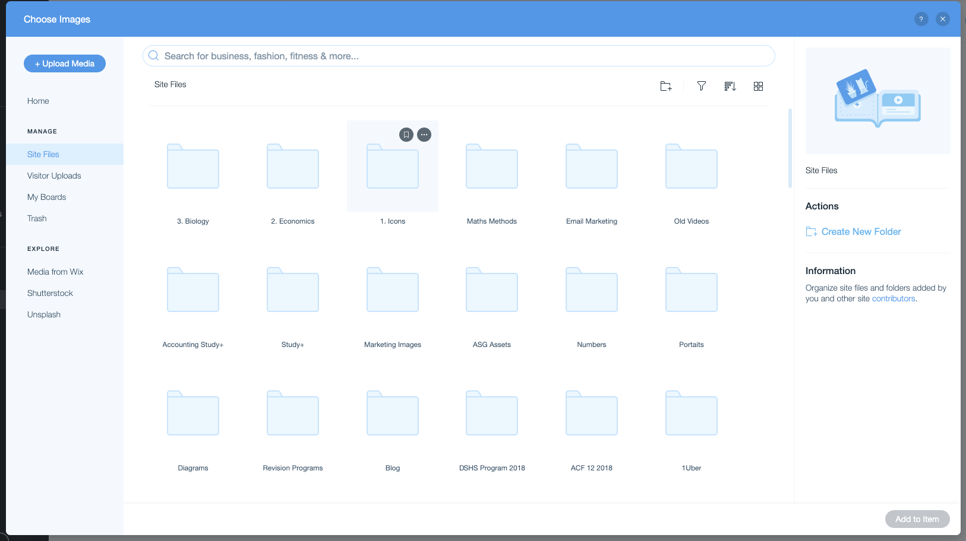
Step 6: Upload Icon
Head to 1. Icons Folder

Slide 32
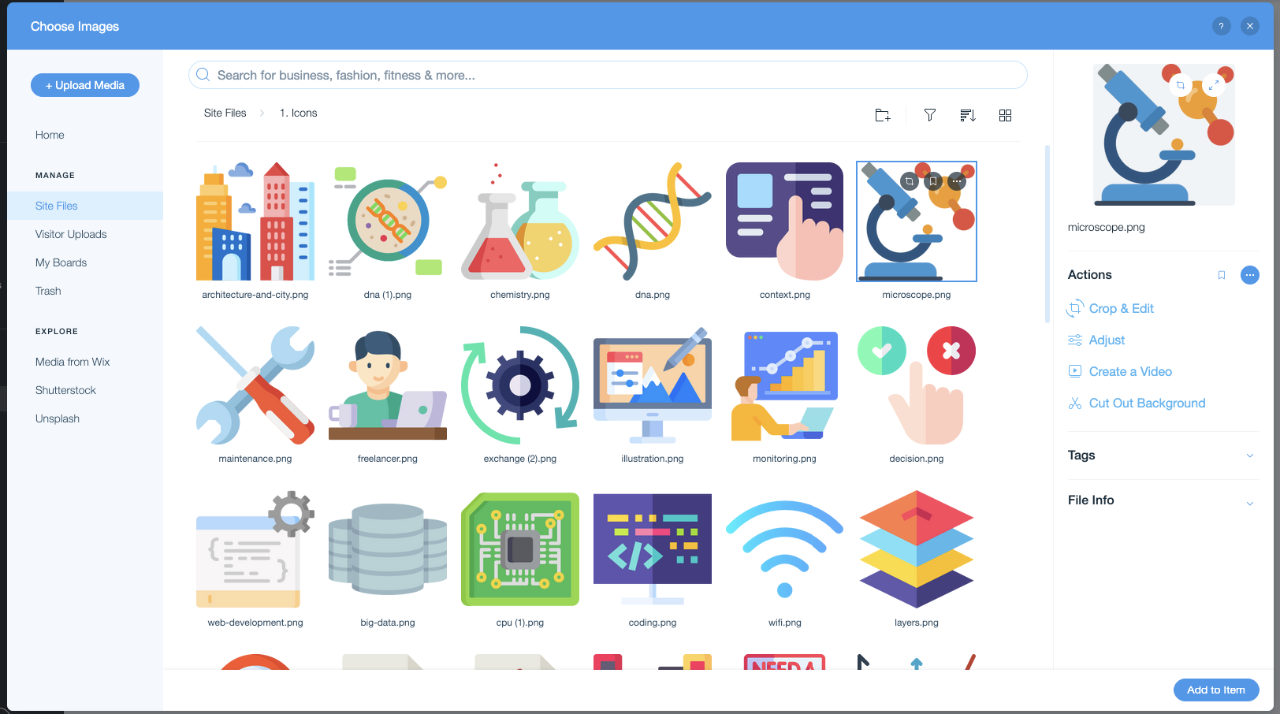
Step 6: Select the Icon
Drag and drop the icon to upload.
Select the icon.

Slide 33
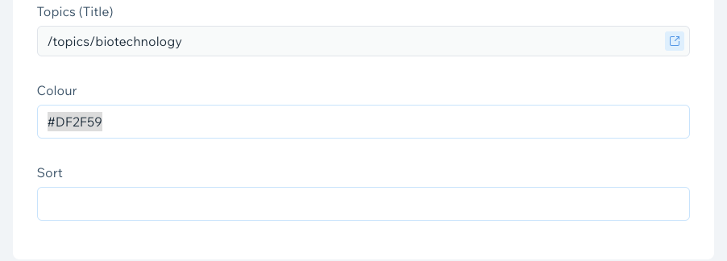
Step 7: Select a Colour
Maths: Red - #DF2F59
Science: Green - #157348
Technologies: Blue - #4E7FFF
Social Sciences & Business: Yellow - #F2B60F

Slide 34
Step 8: Sort It Out
Sorts tell the platform where to order the data.
B 1. 03
Subject letter
(E.g B for biology)
Unit
(E.g 3 for Unit 3)
Topic Rank
(E.g 03 for the 3rd topic on the list).
Important - make sure to put the 0 for single digit ranks.)

Slide 35
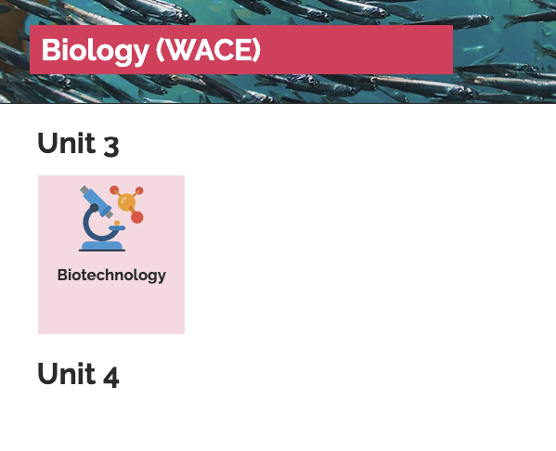
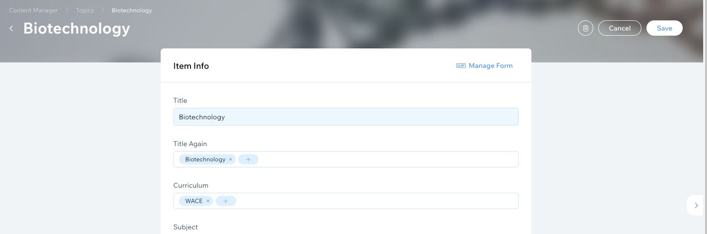
Save and You’re Done!
You should see your topic now appear on the live website.

Slide 36
Creating Note Pages

Slide 37
Step 1: Go to the Content Manager and Select ‘Content’

Slide 38
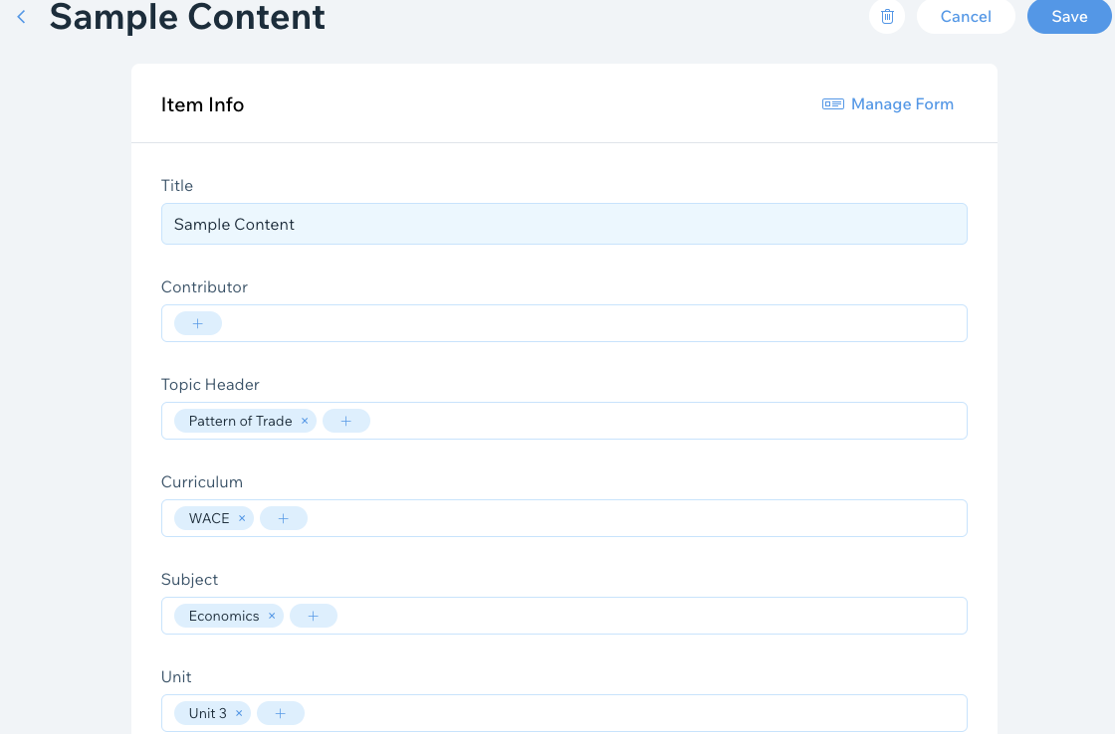
Step 2: Fill Out Descriptive Details
Name of the Content
Contributor - Your Name
Topic Header (Must be Exact Same Wording)
Curriculum (Always WACE)
Subjects (E.g. Economics, Biology)
Unit (E.g. Unit 1, Unit 2, Unit 3, Unit 4)

Slide 39
Step 3: Select Featured Icon
Drag and drop the FlatIcon into the ‘2.Icons’ folder.
Select the icon.

Slide 40
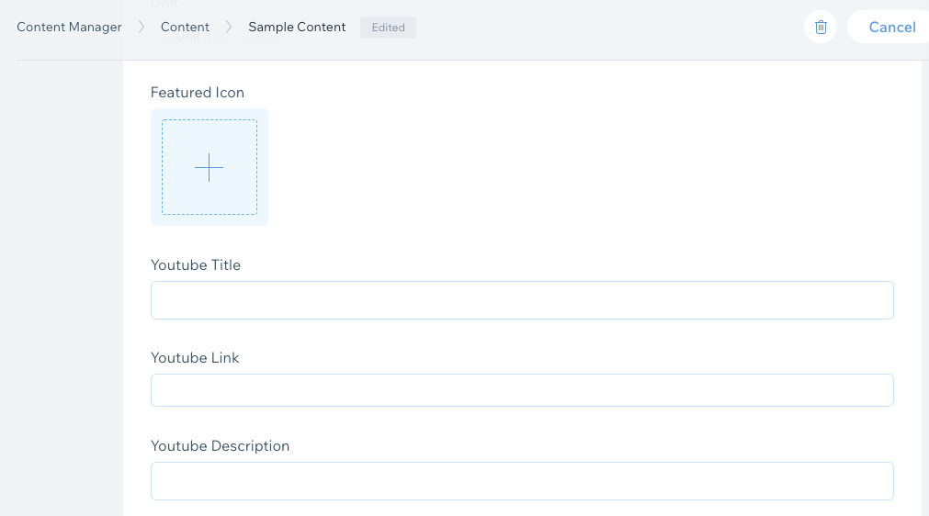
Step 4: Optional - Add YouTube Video
Sometimes there are great videos that explain a specific content. This section is optional but you can add a YouTube video to add to the explanations.
Title of the Video (E.g Exchange Rates | CNBC Video)
YouTube Video URL
Description of the Video, Reference the Author

Slide 41
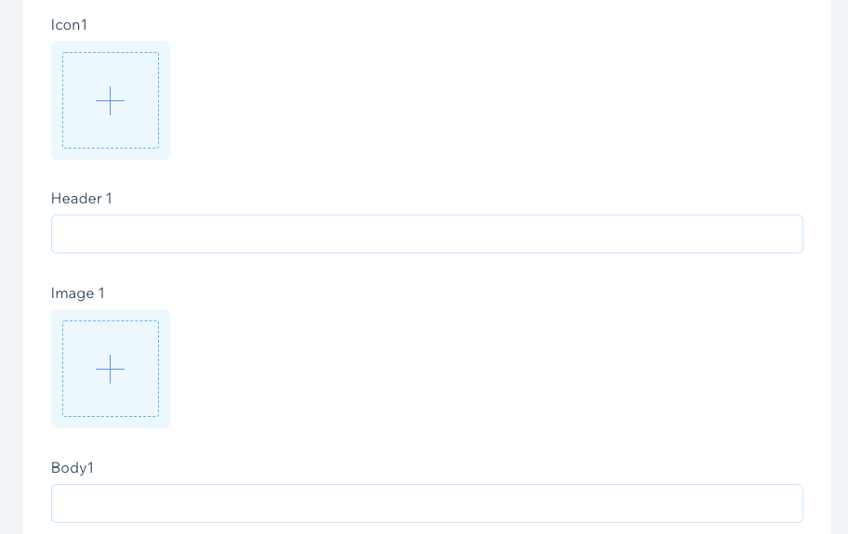
Step 5: Add Content
Icon: The FlatIcon representing the specific point. (Follow step 3 for instructions).
Header: This is the title header of the content.
Image: Optional, but any image you’ve created or sourced from Wiki Commons. For images sourced from Wiki Commons please include a brief attribution in the Body.
Body: The description of the specific point.
You can add up to 10 sections of content. Contact Christian if you need more.

Slide 42
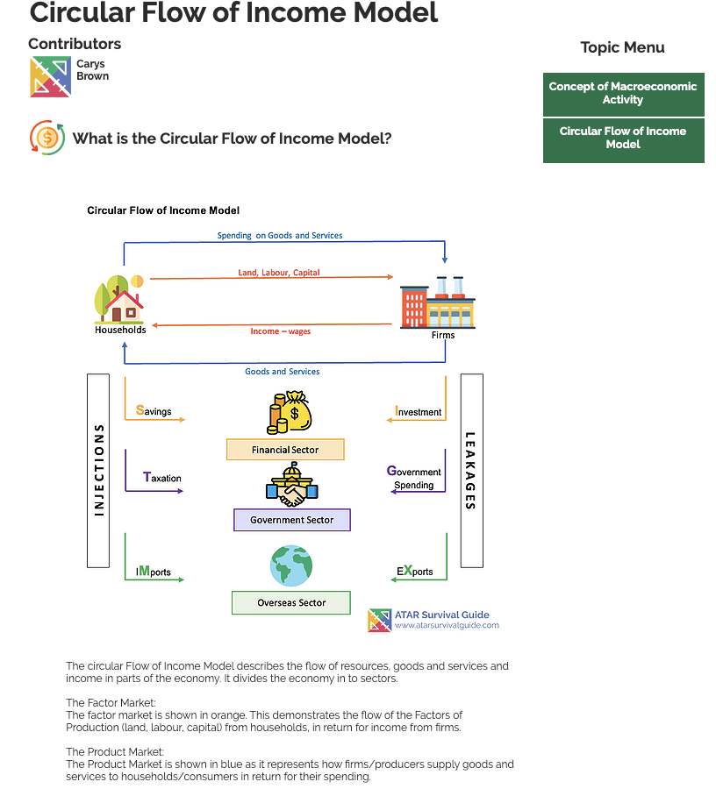
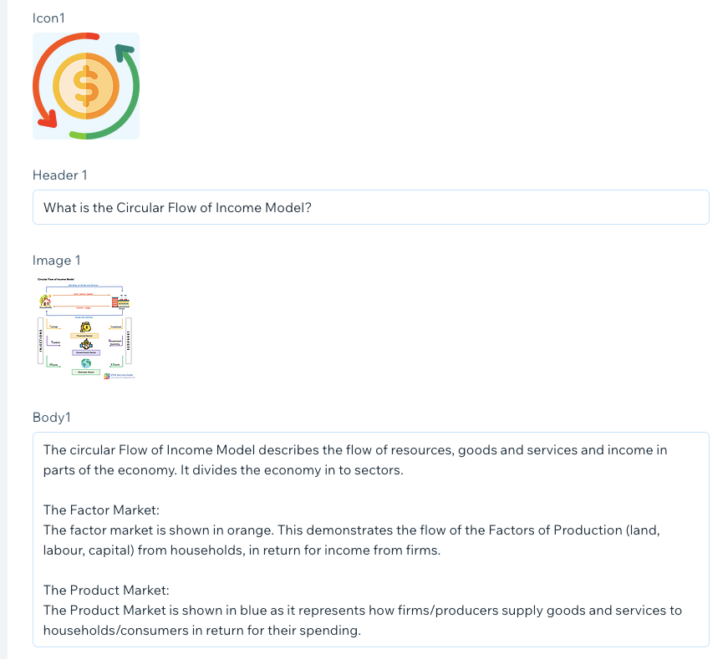
Step 5: Add Content

Slide 43
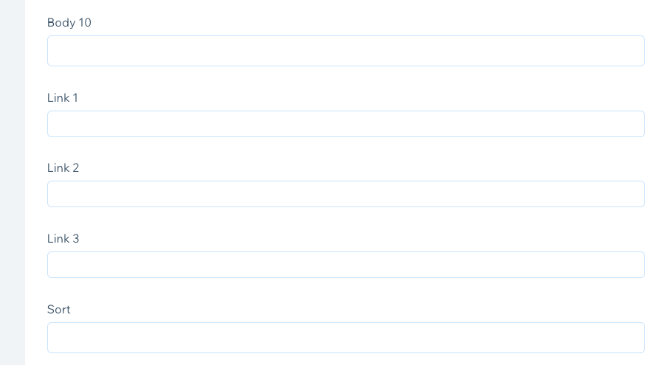
Step 6: Add Any Helpful External Links
You can add any additional external links at the end of each page to assist.
E.g Link to the ABS website for a specific statistic.
You can add up to 3 external links. Contact Christian if you need more.

Slide 44
Step 7: Sort and Save
Sorts tell the platform where to order the data.
B 1. 03. 01
Subject letter
(E.g B for biology)
Unit
(E.g 3 for Unit 3)
Topic Rank
(E.g 03 for the 3rd topic on the list).
Important - make sure to put the 0 for single digit ranks.)
Content Rank
(E.g 01 for the 1st content under the topic.
Important - make sure to put the 0 for single digit ranks.)

Slide 45
Mission Statement:
To be a universal platform that improves student results through effective and attentive study solutions accessible to all.

Slide 46
Creating a Better ASG

